Slide 1
10. Modelling Dependence

Slide 2

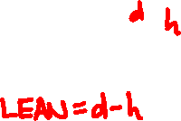



Slide 3

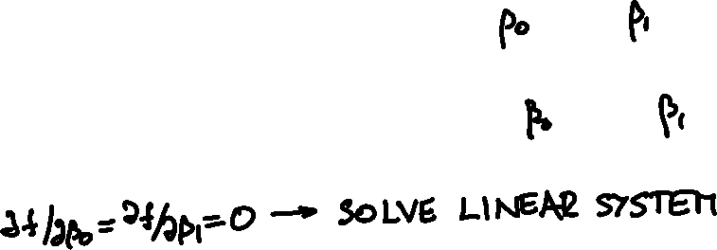

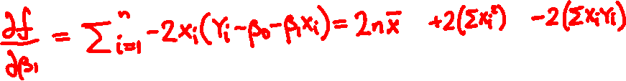
Noisy linear dependence
Y_{i} = β₀ + β₁x_{i} + N_{i}

Slide 4

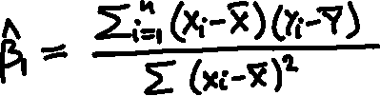
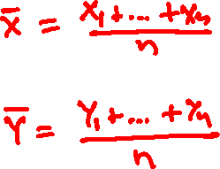
Regression coefficients

Slide 5
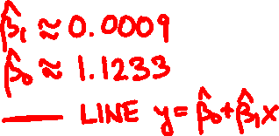
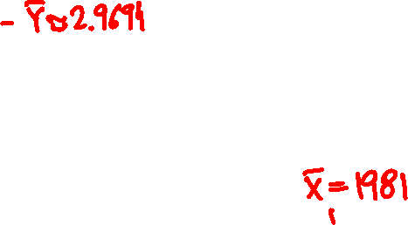

Slide 6
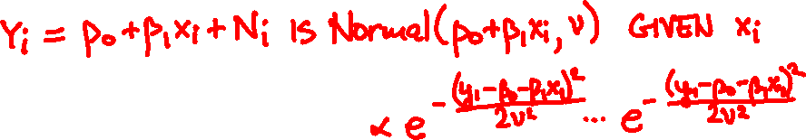


Maximum likelihood interpretation
N₁, …, N_{n} are independent Normal(0, ν)
f_{Y , …, Y} (y₁, …, y_{n} |β₀, β₁)
₁
_{n}

Slide 7
Can you predict the final grade from the midterm grade?
final exam
midterm exam

Slide 8
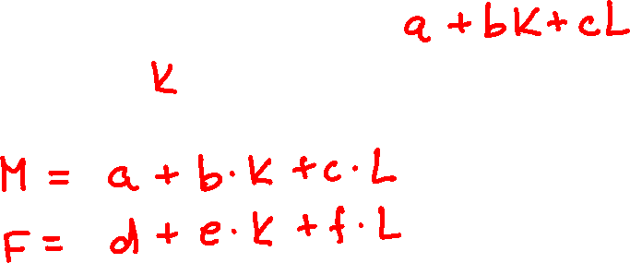
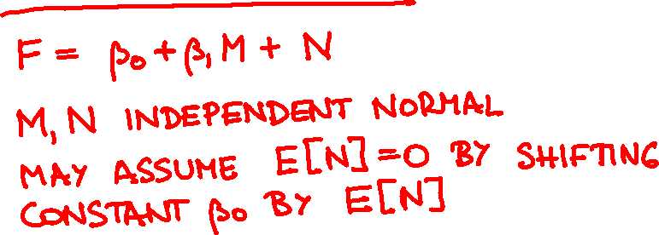


Slide 9
final exam
midterm exam

Slide 10


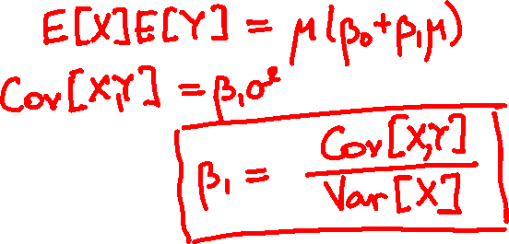

Statistical interpretation
Y = β₀ + β₁X + N
X = Normal(μ, σ)
N = Normal(0, ν)
Cov[X, Y] =

Slide 11

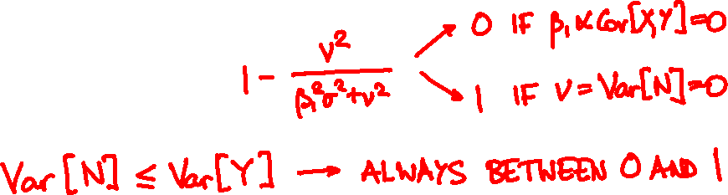
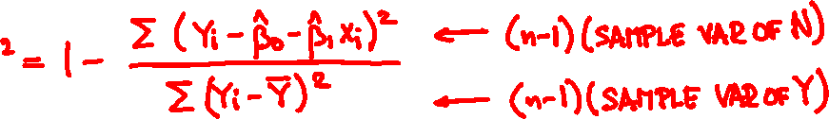
Signal versus noise
Var[N]
1 –
Var[Y]
can be (consistently) estimated by

Slide 12

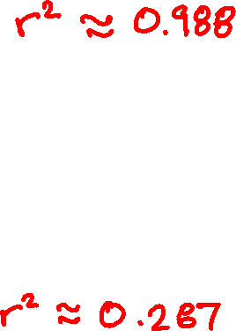

Slide 13
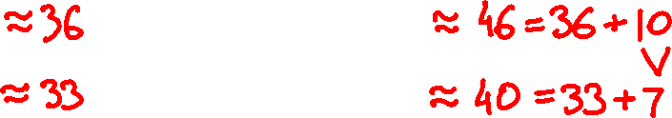
final exam
midterm exam
E[M]
E[M | M ≥ 40]
E[F]
E[F | M ≥ 40]
Notes:
36.28 45.87
33.05 39.87

Slide 14
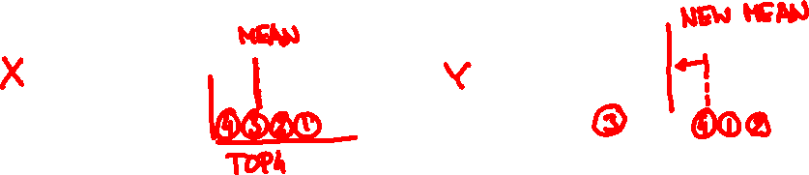

Regression to the mean
If X, Y have same marginals,
E[Y | X ≥ x] ≤ E[X | X ≥ x]
E[Y | X ≤ x] ≥ E[X | X ≤ x]

